Slide 1
Great Falls City Code Enforcement
Joseph Cik, Assistant City Attorney

Slide 2
Summary
How a code enforcement action is started.
How a code enforcement action is investigated.
What options we have to fix any potential violation.
The process by which we abate.
Criminal complaint process.

Slide 3
Written Complaint

Slide 4
Phases of investigation

Slide 5
OCCGF 8.49.010 Nuisance Defined
Safety hazard
Offensive to the senses
Continual zoning violations (vehicles)
This declaration of nuisance by the City Commission is made pursuant to Sections 7-5-4104 and its self-governmental powers under the Charter.

Slide 6
Declaration of Abatement procedure
OCCGF 8.49.020
Declares the need for a nuisance abatement procedure pursuant to City Charter and the MCA.

Slide 7
Lien Procedure for Abatement of Nuisance
Municipalities and other local government entities are authorized to abate nuisances.
MCA 27-30-101
MCA 27-30-202-4
MCA 7-5-4104
MCA 45-8-111 (Public Nuisance criminal sanctions).

Slide 8
OCCGF 8.49.030
A. Imposes a duty on Director of Planning, Law Enforcement, Fire to inspect Nuisance properties.
Allows for the use of a search warrant in furtherance of inspection

Slide 9
8.49.030
B. Notice to all parties interested in the property of the extent of the Nuisance and repairs needed to abate.
(10) days and to complete such work within thirty (30) days from the date of notice.
Notice has to be by certified mail, prepaid, and return receipt requested.

Slide 10
8.49.030
The procedure to get to where we can act on the property:
1. Right of way inspection by authorized personnel.
2. Entrance was made completely examine the extent of the nuisance. Use of a search warrant is sometimes necessary.
3. Staff made a determination of the entirety of the nuisance, determined the owner and any other person or organization with an interest in the property, and provided proper notice.

Slide 11
OCCGF 8.49.040 Notice of hearing before City Commission
If the property owner does not comply with the notice prescribed by Section 8.49.030, by commencing the required work within the time allowed, then it is set for a hearing in front of the City Commission.
Same notice requirements as 8.49.030.

Slide 12
OCCGF 8.49.050 This Hearing
A. At the time fixed on the notice, the City Commission shall proceed to hear the testimony of the City personnel and the testimony of any other interested party who may be present and desire to testify respecting the condition of the property or thing, the estimated cost of repair, demolition, removal or other appropriate action.

Slide 13
8.49.050
B. Upon the conclusion of the hearing, the City Commission will by resolution, declare its findings and in the event it so concludes, it may declare the property or thing to be a nuisance and direct the owner to obtain the proper permits and physically commence abatement of the nuisance within ten (10) days, and to complete said abatement within thirty (30) days by having the property repaired, demolished, removed or other appropriate act necessary to cure the nuisance.

Slide 14
8.49.050
C. Such resolution shall further notify the owner of the property that if the nuisance is not abated, the property will be the subject of repair, demolition, removal, or other appropriate act, as the case may be, by the City and the expenses thereof shall remain a lien on the property.

Slide 15
8.49.050
D. Notice of all of the findings and conclusions are sent to all interested parties by the same means as previous notice.

Slide 16
8.49.050
E. The City Clerk shall file a certified copy of any resolution declaring real property a nuisance with the Cascade County Clerk and Recorder.

Slide 17
8.49.050
F. Allows for time extensions to finish repaires under certain circumstances.

Slide 18
OCCGF 8.49.060-.090
Provisions of the actual abatement itself.
The abatement can be accomplished through the approval of an appropriate contract.
The contract must be approved by Commission Resolution.
City Staff must keep an itemized documentation of costs, which ultimately are recorded by certificate as a lien on the property.
.090 provides a criminal penalty provision.

Slide 19
OCCGF Title 8, Chapter 50 “Public Nuisance”
"Public Nuisance" means:
A. A condition which endangers safety or health, is offensive to the senses, or obstructs the free use of property so as to interfere with the comfortable enjoyment of life or property by an entire community or neighborhood or by any considerable number of persons;
B. Any premises where persons gather for the purpose of engaging in unlawful conduct; or
C. Any condition which renders dangerous for passage any public highway or right-of-way or waters used by the public.

Slide 20
8.50.020
A person commits the offense of maintaining a public nuisance if he knowingly creates, conducts, or maintains a public nuisance.

Slide 21
8.50.040
A person convicted of maintaining a nuisance shall be fined not less than two hundred fifty dollars ($250.00) nor more than five hundred dollars ($500.00) or imprisoned in the County jail for a term not to exceed six (6) months, or both. Each day of such conduct constitutes a separate offense.

Slide 22
No Citations written for Civil Code Violations
Referred to myself for evaluation on best avenue to take.
Criminal actions are filed by complaint accompanied by an affidavit of probable cause.
The idea is not to fine and jail Defendants, but instead, get the problem fixed.

Slide 23
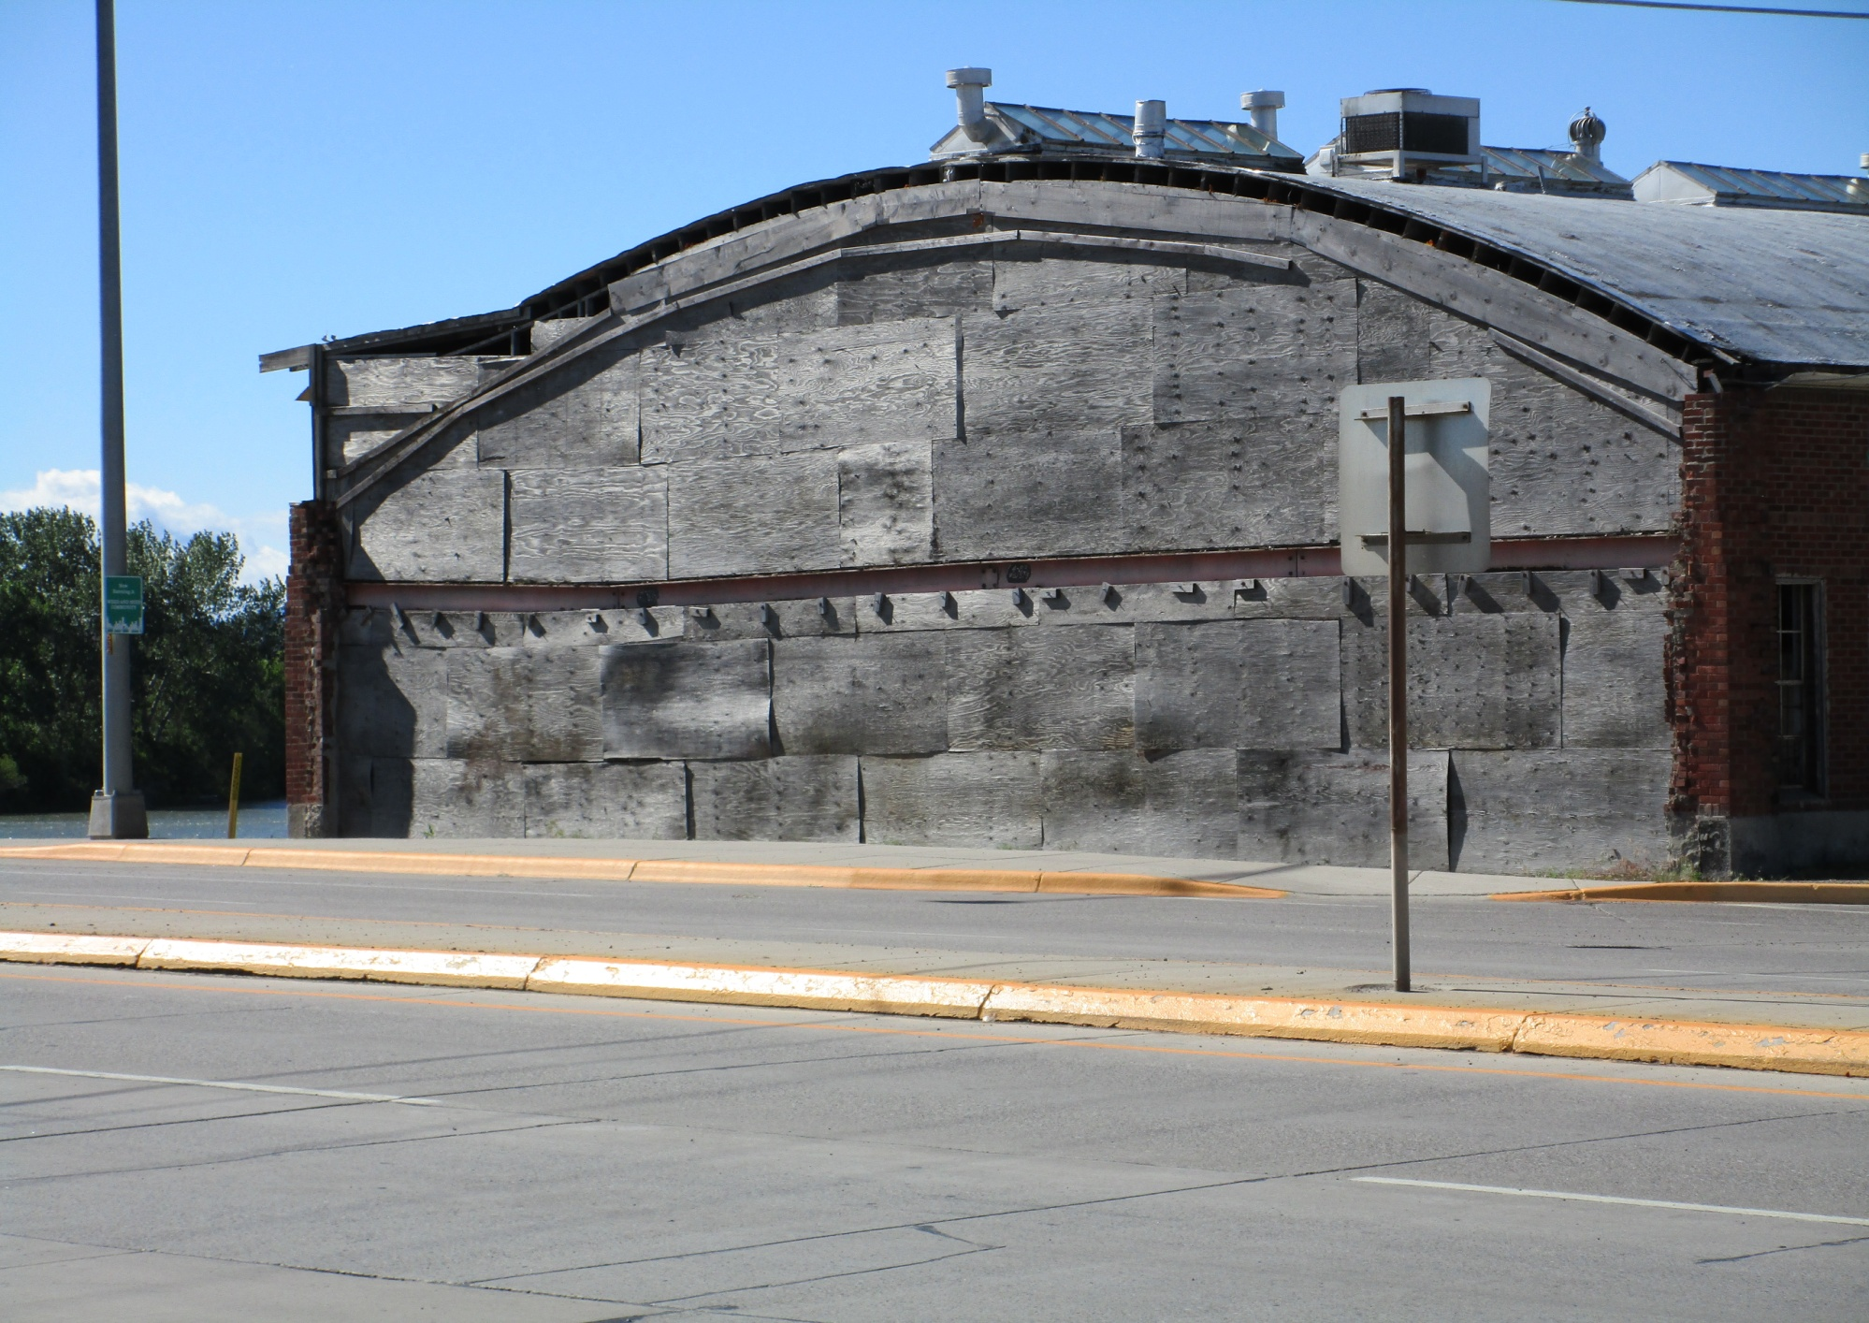

Slide 24
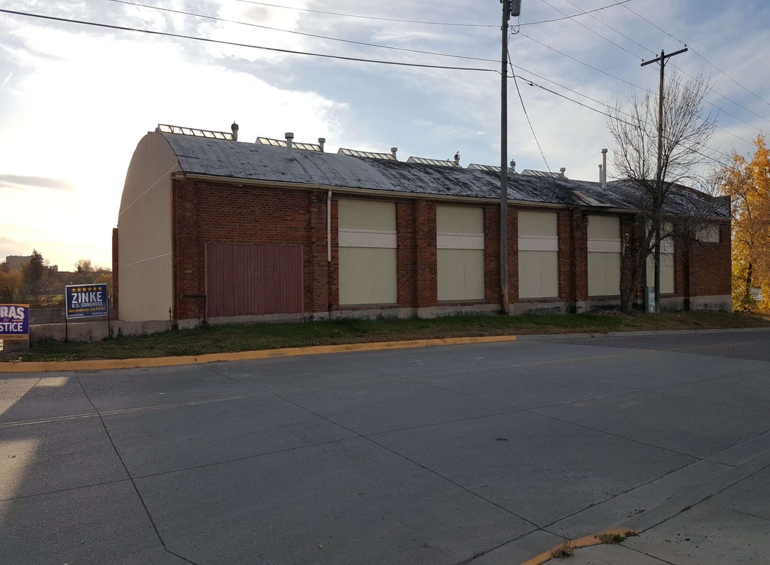

Slide 25
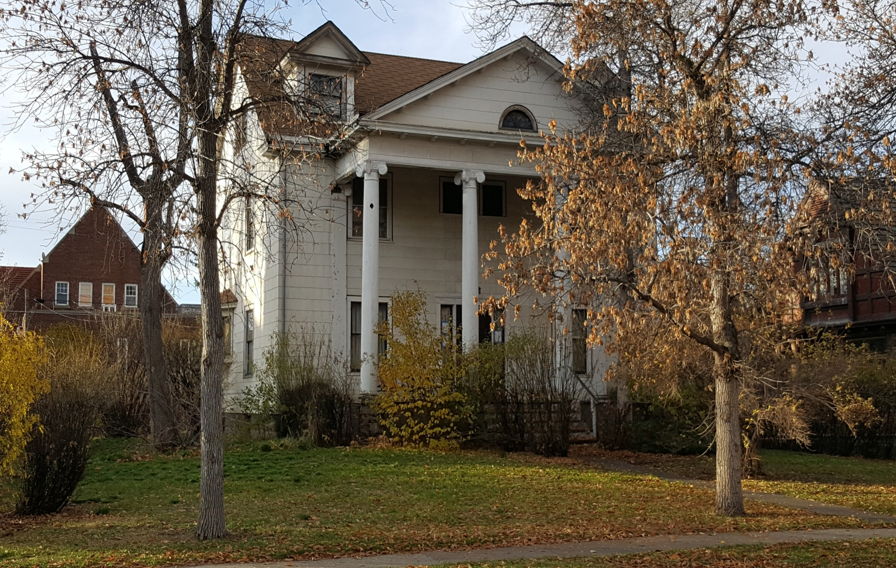

Slide 26
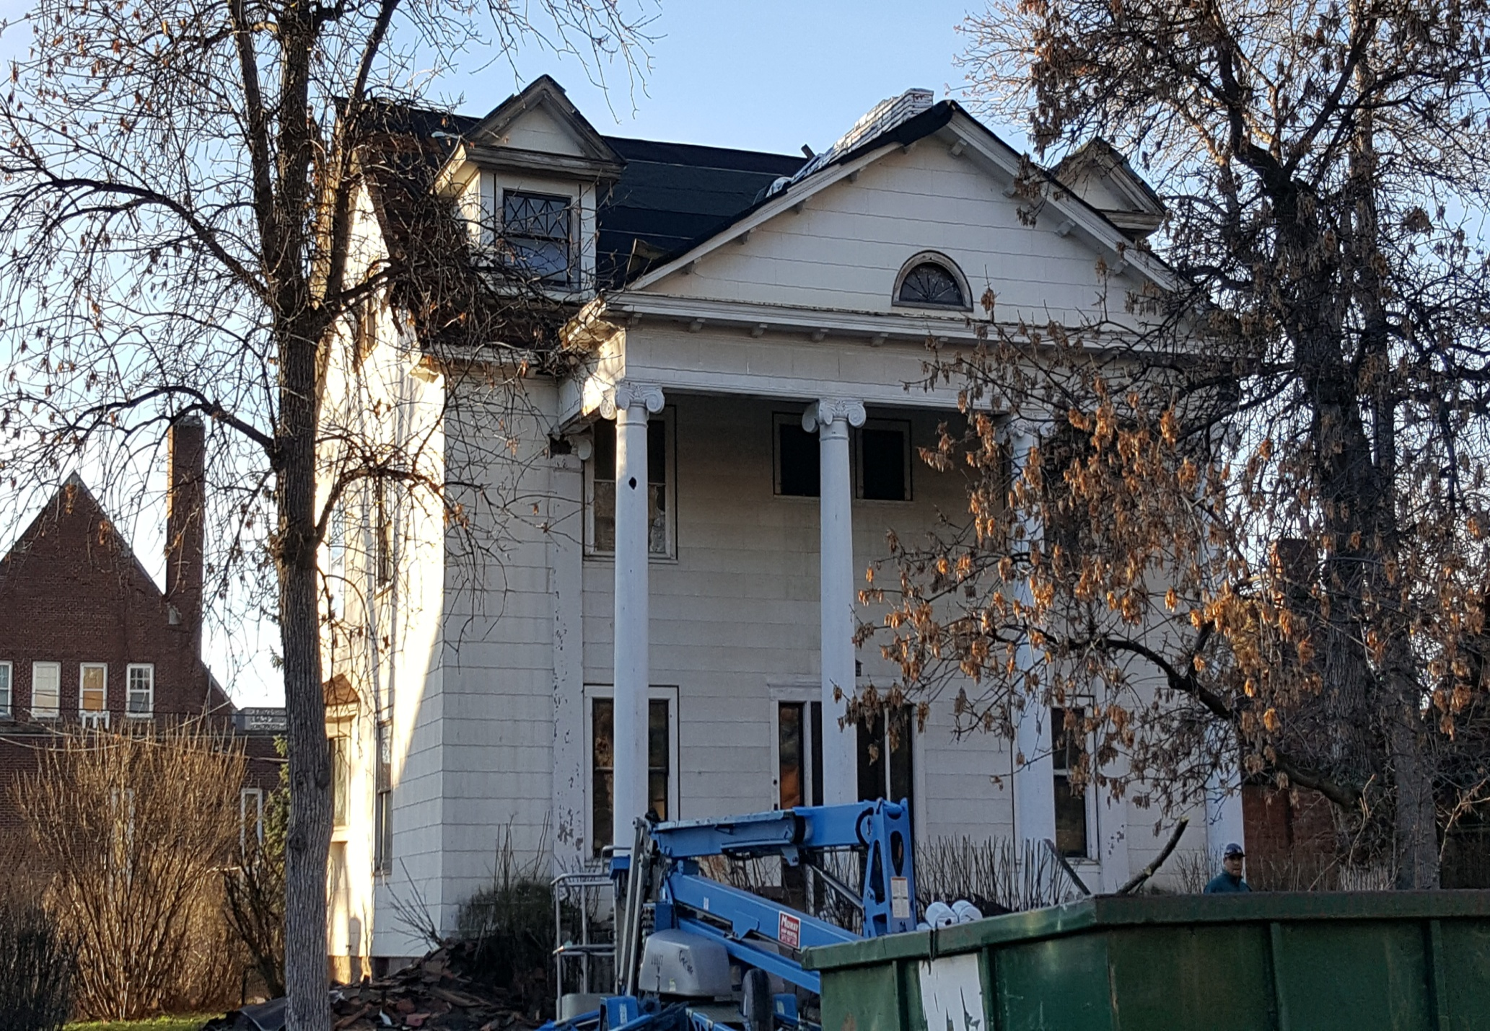

Slide 27
Take away
The process is complaint driven.
The nature of the problem dictates the path that will be taken to fix it.
The ultimate goal is to fix the violation, not to harass or intimidate.

Slide 28
Questions?

